Slide 1
Project Title
Authors
Abstract
Introduction or Background
Goal or Aim
Example:
Growing market in PM leadership training
Have the resources needed
Aim to provide PM leadership training to small/medium-sized organizations
Method
Example:
SWOT Analysis
Industry analysis
Competitor research
Images
Figures
Tables
Example:
Have potential XX competitors doing similar training sessions
Our training focus will instead be XXX
Value Proposition
The unique feature about my innovation/research is: This addresses the problem of:
Add additional details if needed
Example::
Helped us identify our market position
Led to better training strategy and such
References and Acknowledgements (optional)

Slide 2
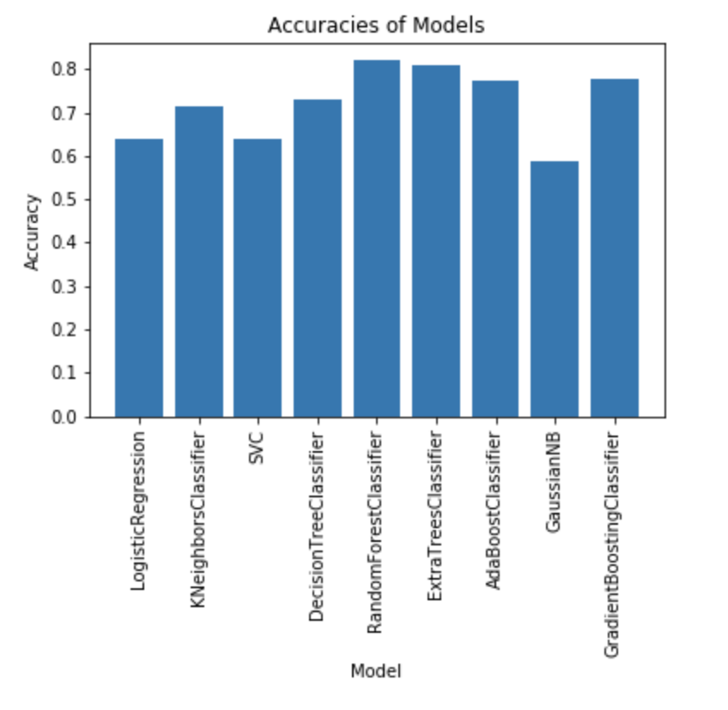
“Sentiment Analysis Study: Comparing Classification Models with Random Forest” by Ryan Martin
how to create the most accurate and feasible machine learning model for sentiment analysis
studies have shown a significant correlation between public mood and the DOW & Jones Industrial Index (Pagolu, Reddy, Panda, & Majhi 2016).
I created an application that can, in near-real-time, characterize the public's mood towards a specific topic by classifying twitter messages with random forest.
Using over 14,000 tweets that have been labelled as positive, negative or neutral.
Trained various models using data to evaluate random forest algorithm and measure its accuracy against other models (AdaBoost, GradientBoost, Logistic Regression, et cetera)
converted my best ML model with Apple’s CoreMLTools, so that it could be used in Xcode as an object to classify parsed JSON data from Twitter’s API
Each instance of positive, negative or neutral was assigned a score and aggregated to predict overall sentiment, which is displayed on the screen
many useful applications for sentiment analysis, such as Google’s flu tracker that can predict disease outbreaks around the world,(Pagolu, Reddy, Panda, & Majhi 2016).
The app allows the user to search for a topic, and see the predicted sentiment of that topic based on the most recent 100 tweets

